Slide 1
Safe and Robust Cooperative Algorithm for Connected Autonomous Vehicles
Mohammad Khayatian

Slide 2
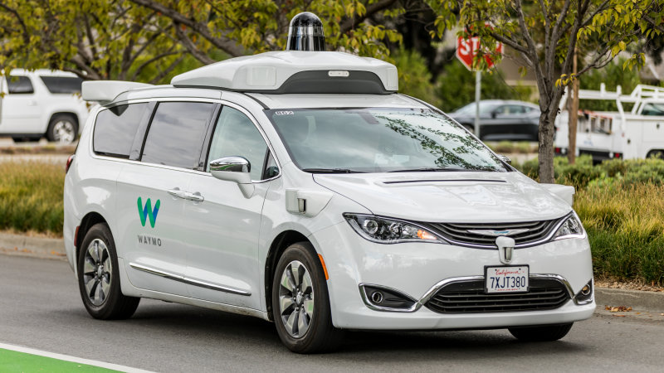
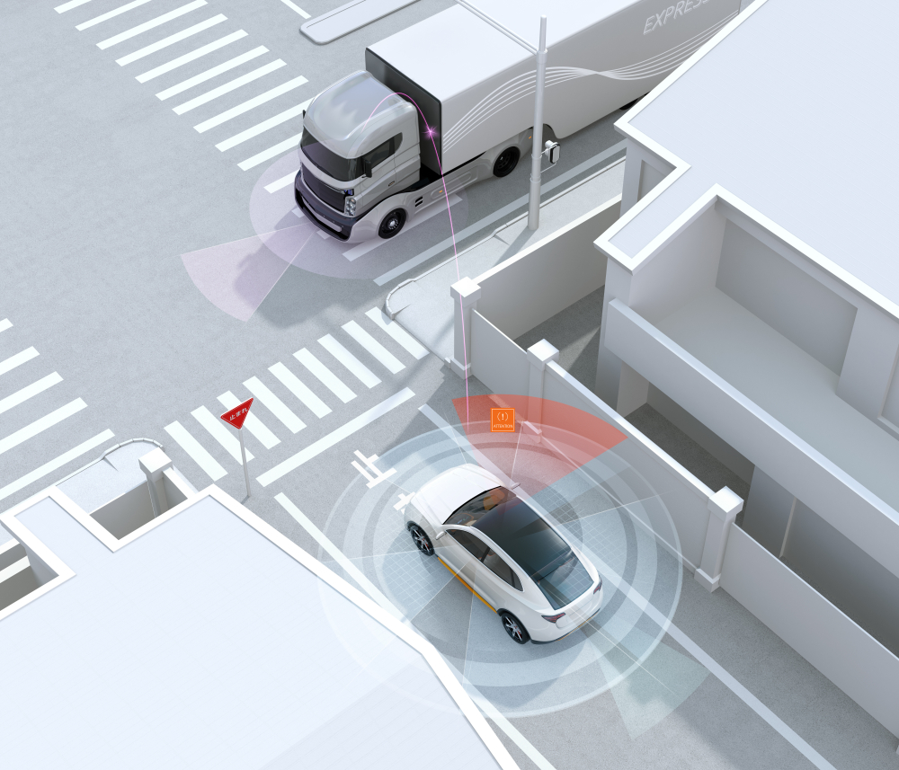
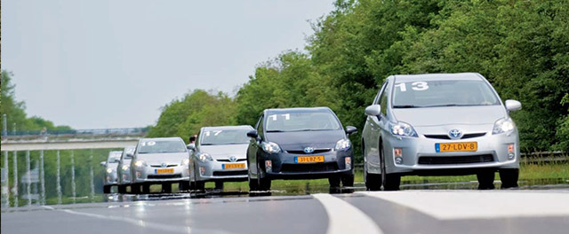
Connected Autonomous Vehicles (CAVs)
Autonomous Vehicles (AVs) have the potential to improve mobility and road safety
Drive efficiently
Avoid accidents that happen due to human error
Connected Autonomous Vehicles (CAVs) can further improve the road efficiency and safety
Sharing their information with other vehicles/infrastructure
Perform cooperative motion planning

Slide 3
Safe and Robust Cooperative Algorithms for CAVs
Thesis statement: Cooperative algorithms should be robust to several kinds of failures in order to be deployed in the real world
Robust against network delay and computation time
Robust against model mismatch and external disturbance
Robust against blame in an accident
Robust against “Rogue Vehicles”
Robust against deadlock

Slide 4
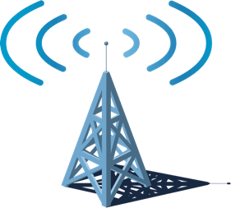
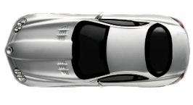
Robust Against Network Delay and Computation Time
Communication delay and computation time of the Intersection Manager (IM) were ignored in previous works
The location at which the request is sent and received are not the same
Round-Trip Delay (RTD) is not deterministic
Ignoring the RTD can cause accidents
Request
Intersection Manager
Response
Best-case Response
Worst-case Response
Request
Assigned Velocity
Velocity
time
Position

Slide 5
Safe and Robust Cooperative Algorithms for CAVs
Thesis statement: Cooperative algorithms should be robust to several kinds of failures in order to be deployed in the real world
Robust against network delay and computation time
Robust against model mismatch and external disturbance
Robust against blame in an accident
Robust against “Rogue Vehicles”
Robust against deadlock

Slide 6
Robust Against Model Mismatches and External Disturbances
Error
Velocity-Assignment (VA) approaches are not robust against
Model mismatches
Controller’s response time
Vehicle dynamics
External disturbances
Wind
Road slope
Road bump
The arrival time of the CAV at the intersection can be different from the desired arrival time
Vehicles that intend to make a turn will be assigned a low velocity to avoid roll-over
Edge of the intersection
Actuation time
Position error due to model mismatch
Position error due to the external disturbance
Assigned Velocity
Disturbance is applied

Slide 7
Safe and Robust Cooperative Algorithms for CAVs
Thesis statement: Cooperative algorithms should be robust to several kinds of failures in order to be deployed in the real world
Robust against network delay and computation time
Robust against model mismatch and external disturbance
Robust against blame in an accident
Robust against “Rogue Vehicles”
Robust against deadlock

Slide 8
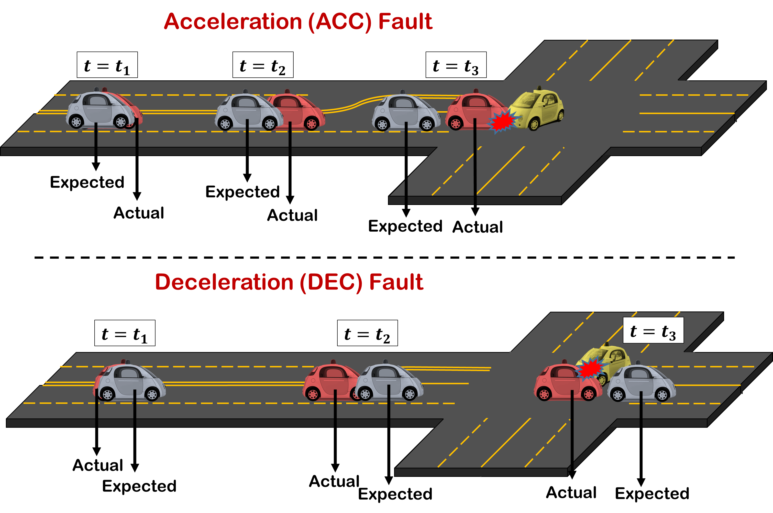
Robust Against Rogue Vehicles
Strong assumption in existing intersection management approaches
CAVs are honest
CAVs follow the assigned trajectory
Rogue Vehicle
What if a CAV sends wrong information?
False position, velocity, or intended direction
What if a CAV does not follow the assigned trajectory ?
The CAV breaks down
Be compromised and accelerates
Two extreme cases are
Deceleration (DEC) fault
Acceleration (ACC) fault

Slide 9
Safe and Robust Cooperative Algorithms for CAVs
Thesis statement: Cooperative algorithms should be robust to several kinds of failures in order to be deployed in the real world
Robust against network delay and computation time
Robust against model mismatch and external disturbance
Robust against blame in an accident
Robust against “Rogue Vehicles”
Robust against deadlock

Slide 10
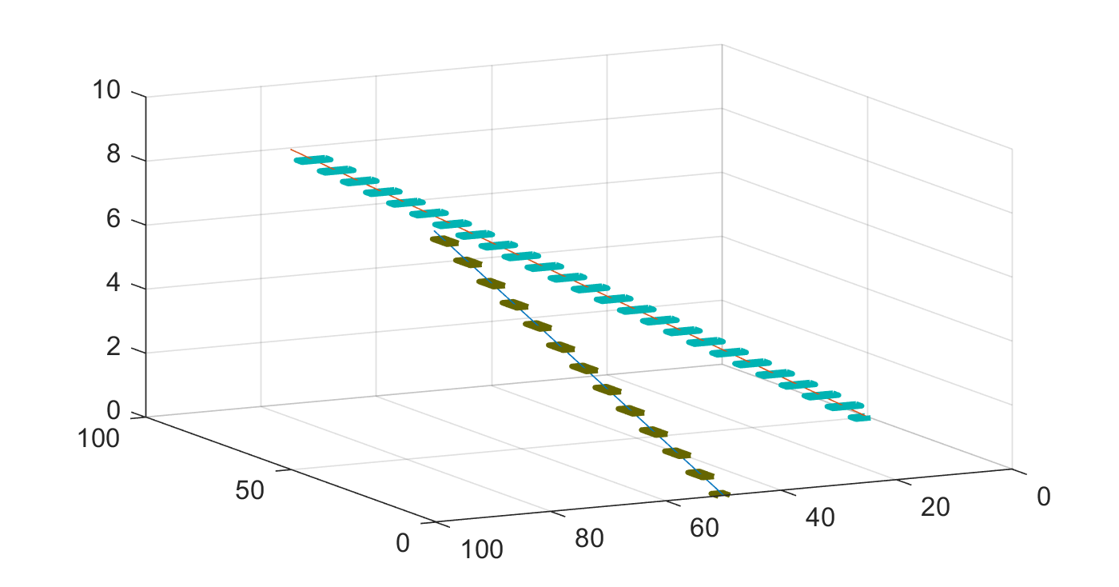
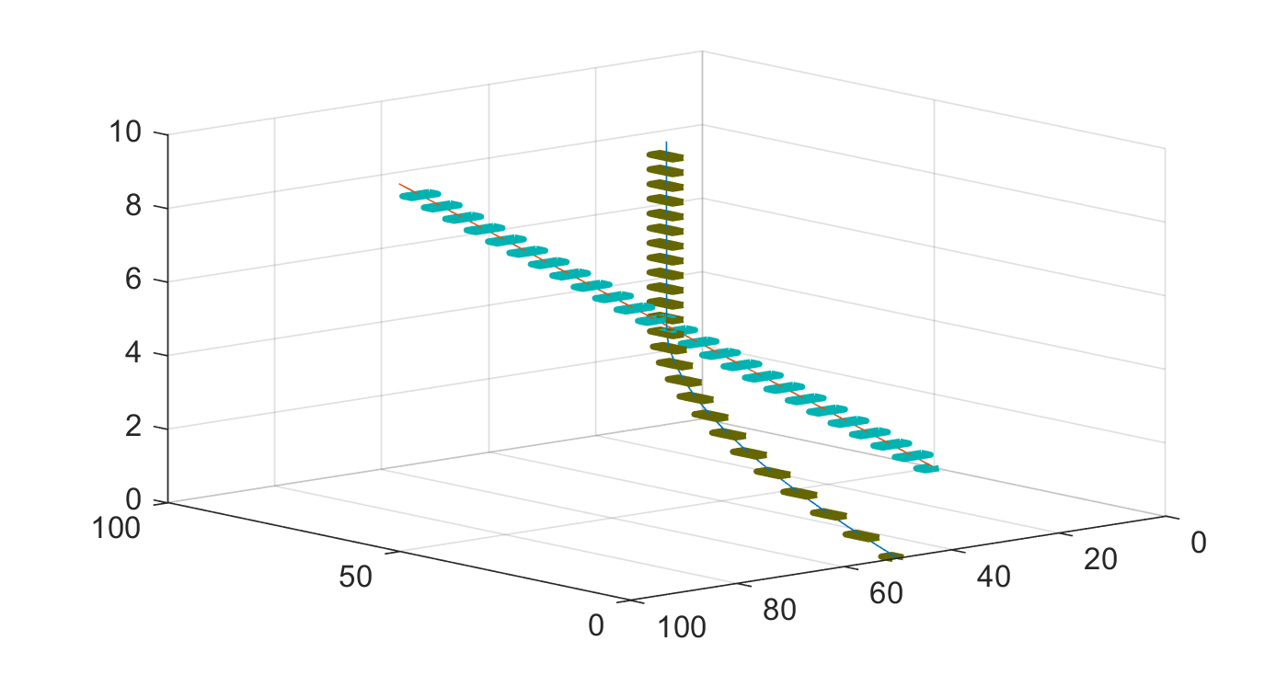
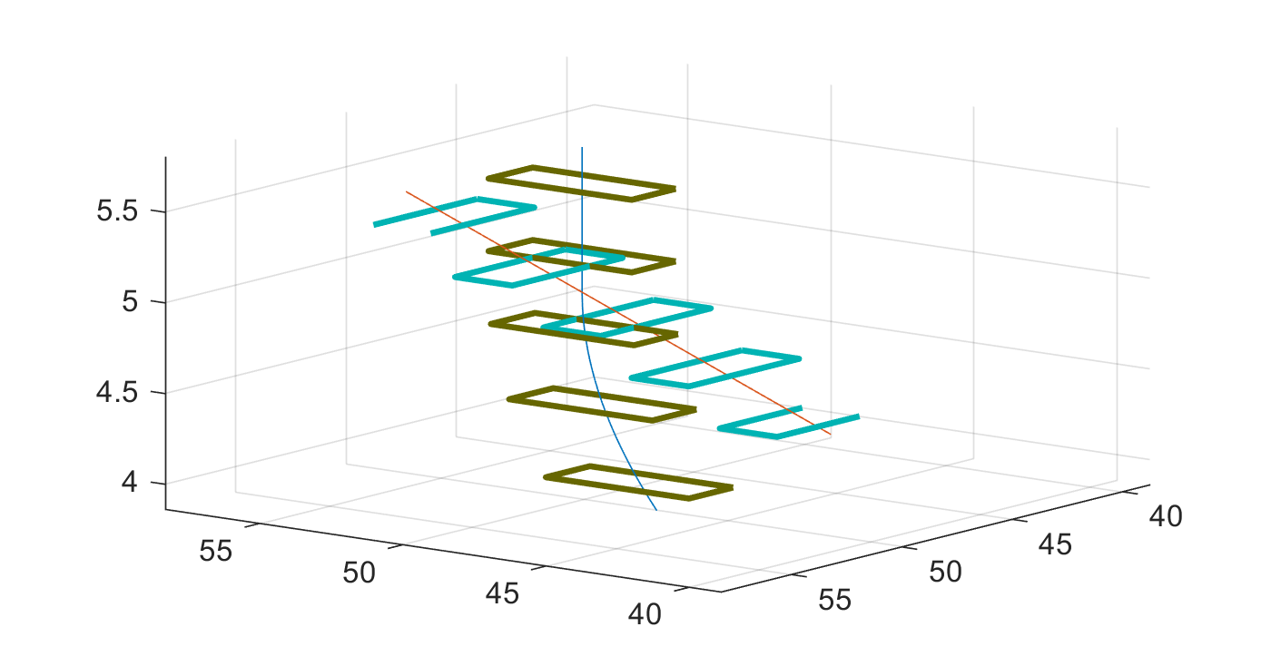
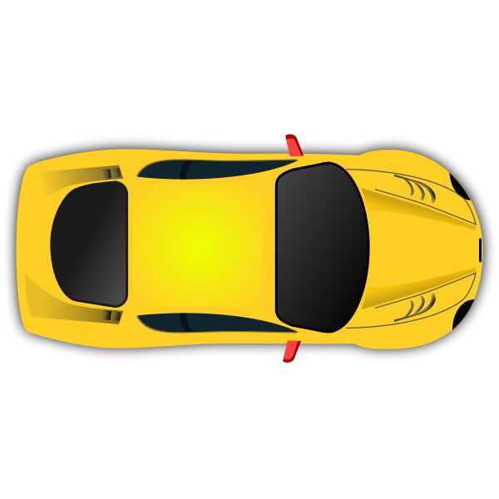
Safe Motion Planning of AVs
Travel from point A to point B and avoid obstacles that can be dynamic
Common motion planning approaches are not absolutely safe [1, 2, 3]
Safety Definition: The future plans of two vehicles are called safe as long the bounding boxes around them do not overlap
A vehicle may have to change its plan suddenly
Responsibility-Sensitive Safety (RSS) [4]
Reduce the problem of not being involved in an accident to not being blamed for an accident
If all AVs follow the RSS rules, there will be no accidents
RSS considers the worst-case behavior for other vehicles
[1] Mohanan, M. G., and Ambuja Salgoankar. "A survey of robotic motion planning in dynamic environments." Robotics and Autonomous Systems 100 (2018): 171-185.
[2] Rossi, Federico, et al. "Review of multi-agent algorithms for collective behavior: a structural taxonomy." IFAC-PapersOnLine 51.12 (2018): 112-117.
[3] Bekris, Kostas E., Konstantinos I. Tsianos, and Lydia E. Kavraki. "A decentralized planner that guarantees the safety of communicating vehicles with complex dynamics that replan online." 2007 IEEE/RSJ International Conference on Intelligent Robots and Systems. IEEE, 2007.
[4] Shalev-Shwartz, Shai, Shaked Shammah, and Amnon Shashua. "On a formal model of safe and scalable self-driving cars." arXiv preprint arXiv:1708.06374 (2017).

Slide 11
The Original RSS Rules
Longitudinal Rule [1]:
Maintain a minimum longitudinal distance
$ρ$ is the response time of the ego vehicle
Lateral Rule [1]:
Maintain a minimum lateral distance
$μ$ is a constant for safety
$v_{1,ρ }$ is the velocity after acceleration
[1] https://www.mobileye.com/responsibility-sensitive-safety/

Slide 12
Limitations of the Original RSS Rules
RSS proposes a “Lane-based” coordinate system
Cannot be applied where there is no lane marking
Cannot be applied to unstructured roads
Uncontrolled intersection and merge scenarios are not covered
The definition of “lane” is ambiguous
Longitudinal and lateral directions are not clear
Deadlocks are not considered
AVs may wait forever yielding to each other

Slide 13
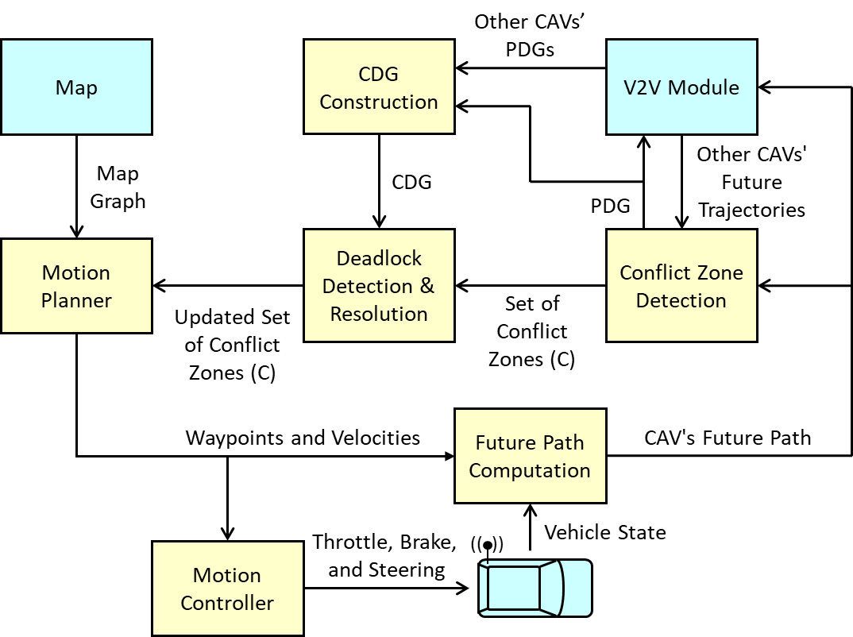
Overview of Proposed Algorithm
1) Each CAV computes its future path and broadcasts it along with other info (ID, position, velocity, etc.)
2) Upon receiving paths of other CAVs, the ego CAV detects if there are conflict zones
3) The ego CAV determines if it has the advantage/disadvantage for detected conflict zones
4) The Partial Dependency Graph (PDG) is computed and broadcast
5) Upon receiving PDGs of other CAVs, the Complete Dependency Graph (PDG) is constructed
6) Deadlocks are resolved (if any)
7) Motion planner acts if the ego CAV has a disadvantage over a conflict zone

Slide 14
Conflict Zone & Advantage
1) Each CAV broadcasts its future path (length = $d_{max}$)
The future plan is a set of waypoints
2) Conflict zones defined for a pair of CAVs
A subset of future waypoints of CAVs where the distance between the paths is less than a threshold (Threshold is smaller than lane size)
Two CAVs may have more than one conflict zones: $C =\{C_{1},C_{2}, …, C_{n}\}$
3) The CAV with earlier expected “time of arrival” has the “advantage” to enter the conflict zone first if not dictated by the rules-of-the-road
The CAV with a disadvantage must change its plan to avoid a possible accident
Conflict Zone 1
Conflict Zone 2

Slide 15
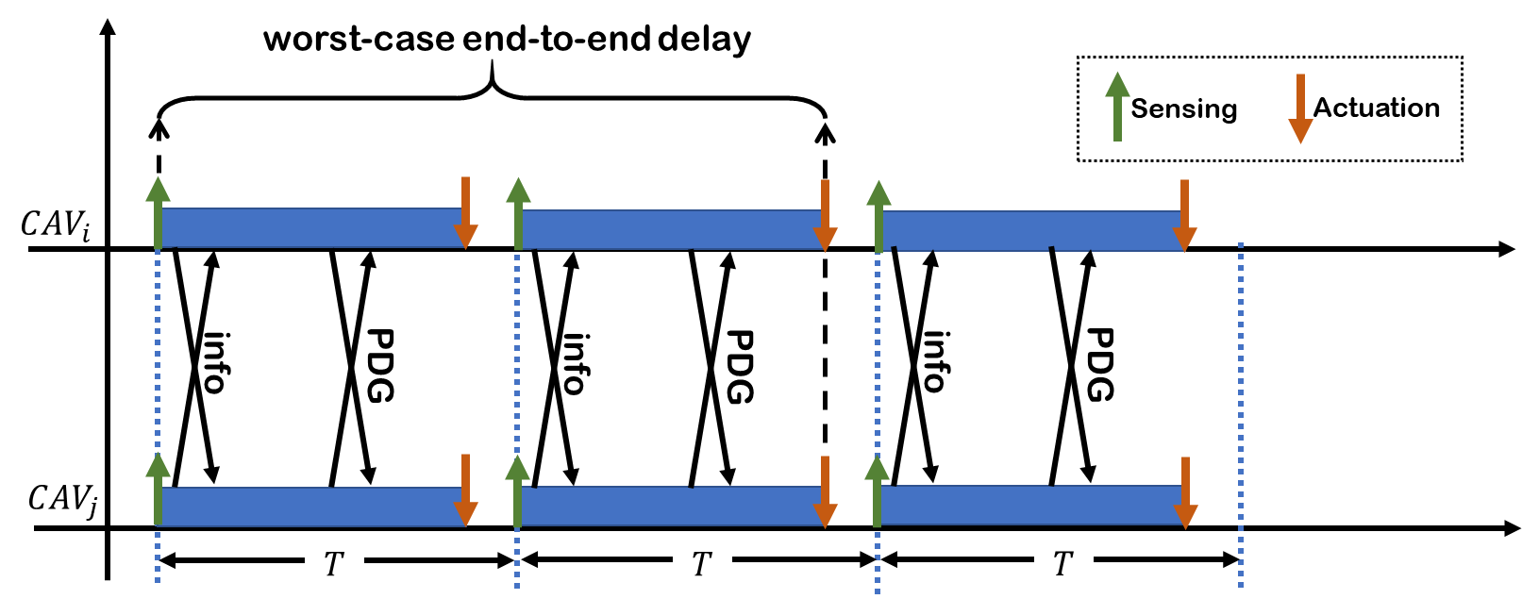
Information Broadcasting
Broadcasting information (position, velocity, ID, future path) and PDG periodically and in sync
Initially, does the CAV with a disadvantage have enough distance to safely stop?
The length of future path accounts for the “worst-case” scenario ($d_{max}$)
$d_{max}=v_{max}ρ+d_{b}$
$ρ=2T$ is the worst-case end-to-end delay
$d_{b}$ is the breaking distance $d_{b}=\frac{v_{max}^{2}}{{2|a}_{brake}|}$
$$v$$
$$v_{max}$$
$$d_{b}$$
$$t$$
$$ρ$$

Slide 16
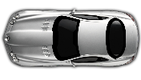
Our RSS-based Definition of Safety
Proposed RSS rule:
The CAV with disadvantage should always maintain a minimum distance of $d_{Safe}^{D}$from its conflict zones only if it is possible that the CAV with the advantage stops inside the conflict zone
$d_{Safe}^{D} =\left\{\begin{matrix}d_{Stop}^{D}−d_{extra}^{A}+\frac{VL_{A}+VL_{D}}{2} & d_{end}^{A}>d_{Stop}^{A} \\ 0 & otherwise\end{matrix}\right.$
Important condition: $d_{Safe}^{D} > v_{D}ρ+\frac{1}{2}a_{Acc}ρ^{2}$
$d_{Stop}^{D}=v_{D}ρ+\frac{1}{2}a_{Acc}ρ^{2}+\frac{{\left(v_{D}+a_{ACC}ρ\right)}^{2}}{2|a_{Brake}|}$
$d_{Stop}^{A}=\frac{v_{A}^{2}}{2|a_{Brake}|}$
$d_{end}^{A}$: distance of the CAV with advantage from the end of conflict zone
$d_{extra}^{A}$: how much extra room does the CAV with the advantage make for the CAV with a disadvantage?
This scenario $d_{extra}^{A}=d_{stop}^{A}$
$$d_{stop}^{D}$$
$$d_{stop}^{A}$$
$$d_{end}^{A}$$
Rear
Front
Conflict Zone

Slide 17
Intersection Scenarios
$$d_{Stop}^{A}$$
$d_{Safe}^{D} =\left\{\begin{matrix}d_{Stop}^{D}−d_{extra}^{A}+\frac{VL_{A}+VL_{D}}{2} & d_{end}^{A}>d_{Stop}^{A} \\ 0 & otherwise\end{matrix}\right.$
$d_{extra}^{A}=0$
The CAV with advantage leaves the conflict area quickly in this scenario
Advantage
$$d_{end}^{A}$$
Conflict
zone
$$d_{Stop}^{D}$$
Disadvantage

Slide 18
Merge Scenarios
$d_{Safe}^{D} =\left\{\begin{matrix}d_{Stop}^{D}−d_{extra}^{A}+\frac{VL_{A}+VL_{D}}{2} & d_{end}^{A}>d_{Stop}^{A} \\ 0 & otherwise\end{matrix}\right.$
$d_{extra}^{A}=\left\{\begin{matrix}0 & d_{Stop}^{A}<d_{merge}^{A} \\ d_{Stop}^{A}−d_{merge}^{A} & d_{Stop}^{A}≥d_{merge}^{A}\end{matrix}\right.$
The CAV with advantage travels inside the conflict zone after entering the merge
$$d_{end}^{A}$$
$$d_{merge}^{A}$$
$$d_{Stop}^{A}$$
Advantage
Conflict Zone
Disadvantage
$$d_{stop}^{D}$$

Slide 19
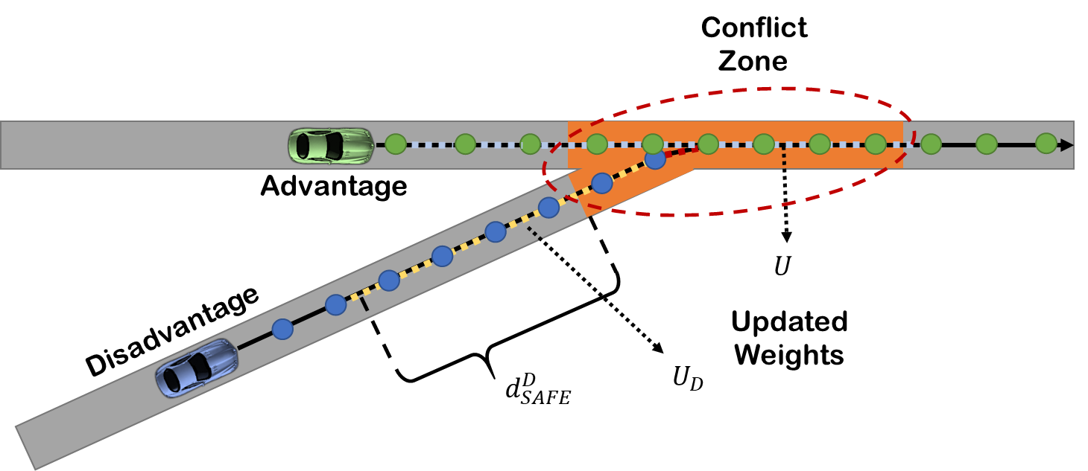
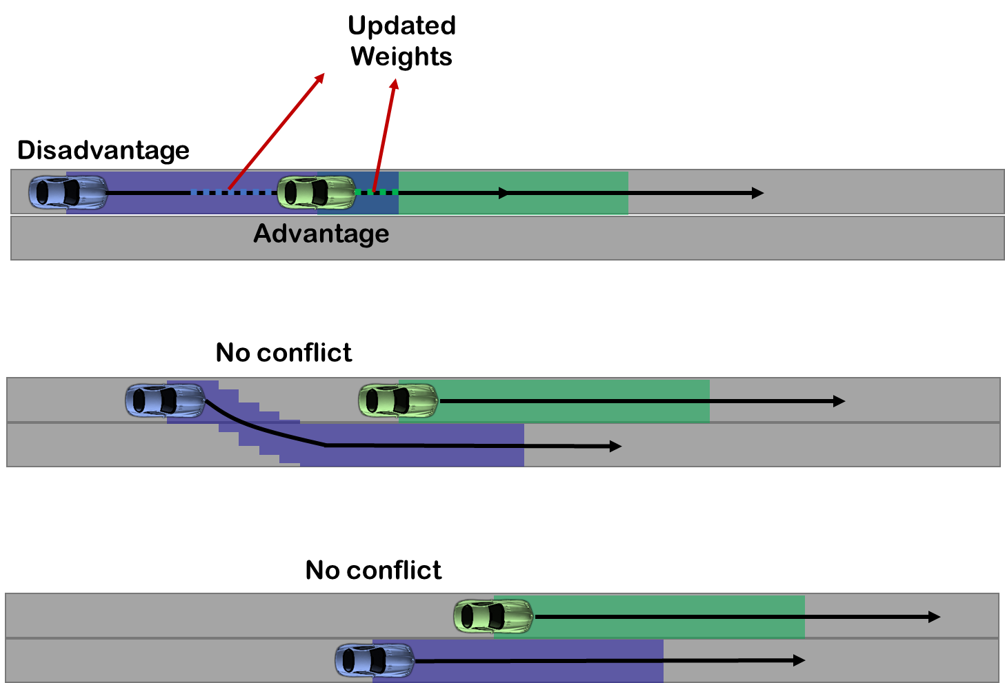
RSS-based Motion Planning
Weights specify the travel time for an edge (segments of the road)
$w=\max\left(\frac{d_{i}}{v_{i}}, M\right),$where $M$ is a large number
1) The CAV with a disadvantage determines the set of waypoints that are inside the conflict zone ($U$) or within the minimum safety distance ($d_{safe}^{D}$) of the conflict zone ($U_{D}$)
2) Update the weights of the edges connected to waypoints in the set $U$ and $U_{D}$ based on the safe velocity and run shortest path
$v_{Safe} =max⁡(\frac{−\left(2ρ a_{ACC} +2\left|a_{brake}\right|\right)+\sqrt{Δ}}{2},0)$
Where $Δ=4 \left(a_{brake}^{2}+2 a_{ACC}ρa_{brake}−a_{ACC}ρ^{2}a_{brake}−2 d_{C}\left|a_{brake}\right|\right)$
3) Apply the shortest path algorithm (Dijkstra)
4) A new path is selected only if it doesn’t cause a new conflict

Slide 20
Motion Controller
$\dot{x}=v\cos\left(θ\right)$
$\dot{y}=v\sin\left(θ\right)$
$\dot{θ}=\frac{v}{L}\tan\left(ψ\right)$
$\dot{v}=a$
$$ψ$$
Vehicle model:
Pure Pursuit Algorithm
Determine the look ahead point ($x_{l}, y_{l}$) that is $l$ meters away
Determine the reference heading$θ_{ref}=atan2\left(x−x_{l},y−y_{l}\right)$
Heading error: $e_{θ}=θ_{ref}−θ$
Steering input: $ψ=k_{P} e_{θ}+k_{I}∫e_{θ}+k_{D}{\dot{e}}_{θ}$
Velocity Control
Use weights of the edges to determine the reference velocity ($v_{ref}$)
Velocity error: $e_{v}=v_{ref}−v$
Throttle/brake input: $a=k_{P}^{′}e_{v}+k_{I}^{′}∫e_{v}+k_{D}{\dot{e}}_{v}$
$$θ$$
$$y$$
$$L$$
$$x$$

Slide 21
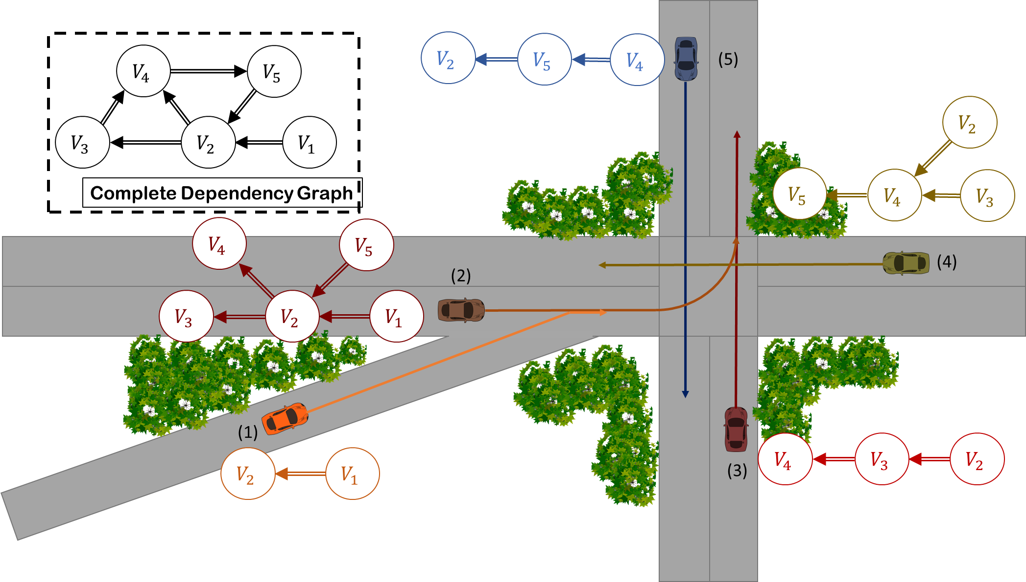
Deadlock Detection and Resolution
Deadlocks can happen
Each CAV broadcasts its “PDG” graph
Indicating how CAVs are yielding to each other
Each CAV constructs the CDG from received PDGs and its own PDG
The cycle is removed by selecting a leader (has the earliest average arrival time)
Lack of Cycle ensure deadlock freeness

Slide 22
Testbed and Simulator
Extract a desired map from OpenStreetMap
Build the graph (road waypoints and edges)
Run a scenario on my simulator (MATLAB)

Slide 23
Demo of Our Simulator
Two loops
The large loop has two lanes per road
The smaller loop has one lane per road
A 4-way intersection
Two merging points
CAVs are initialized with a desired velocity and fixed destination
The destination is modified when it is reached

Slide 24
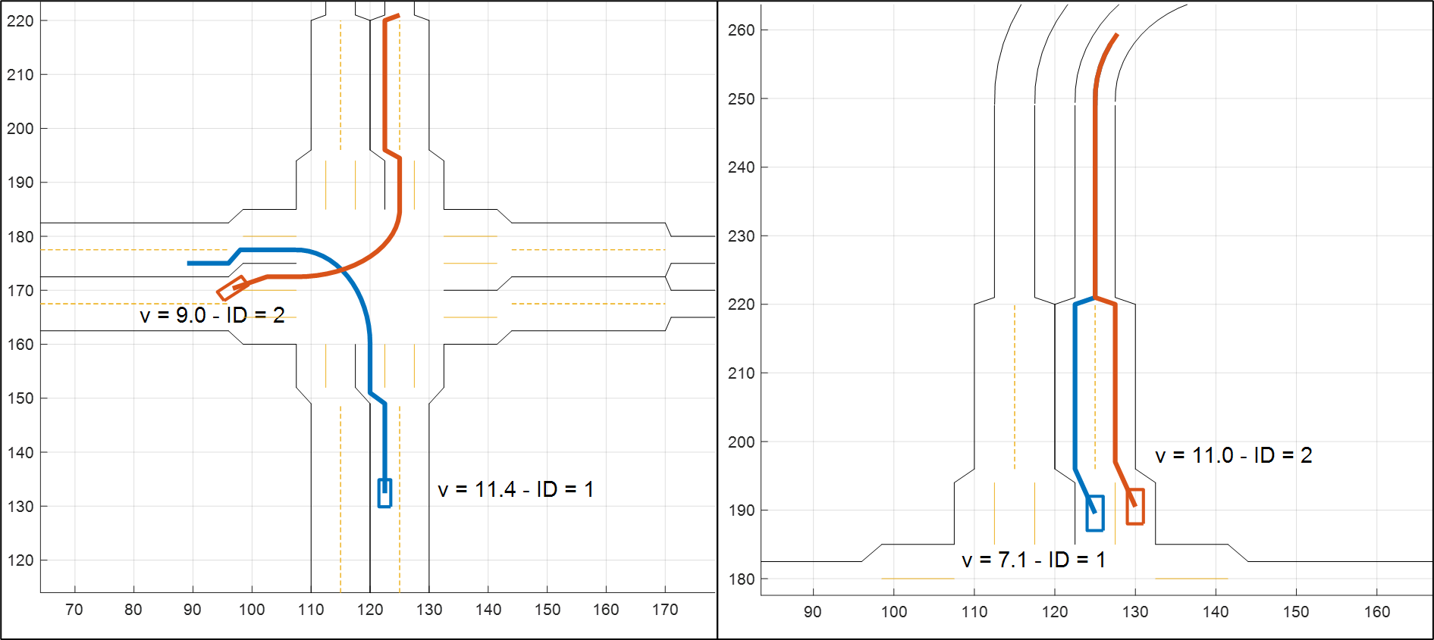
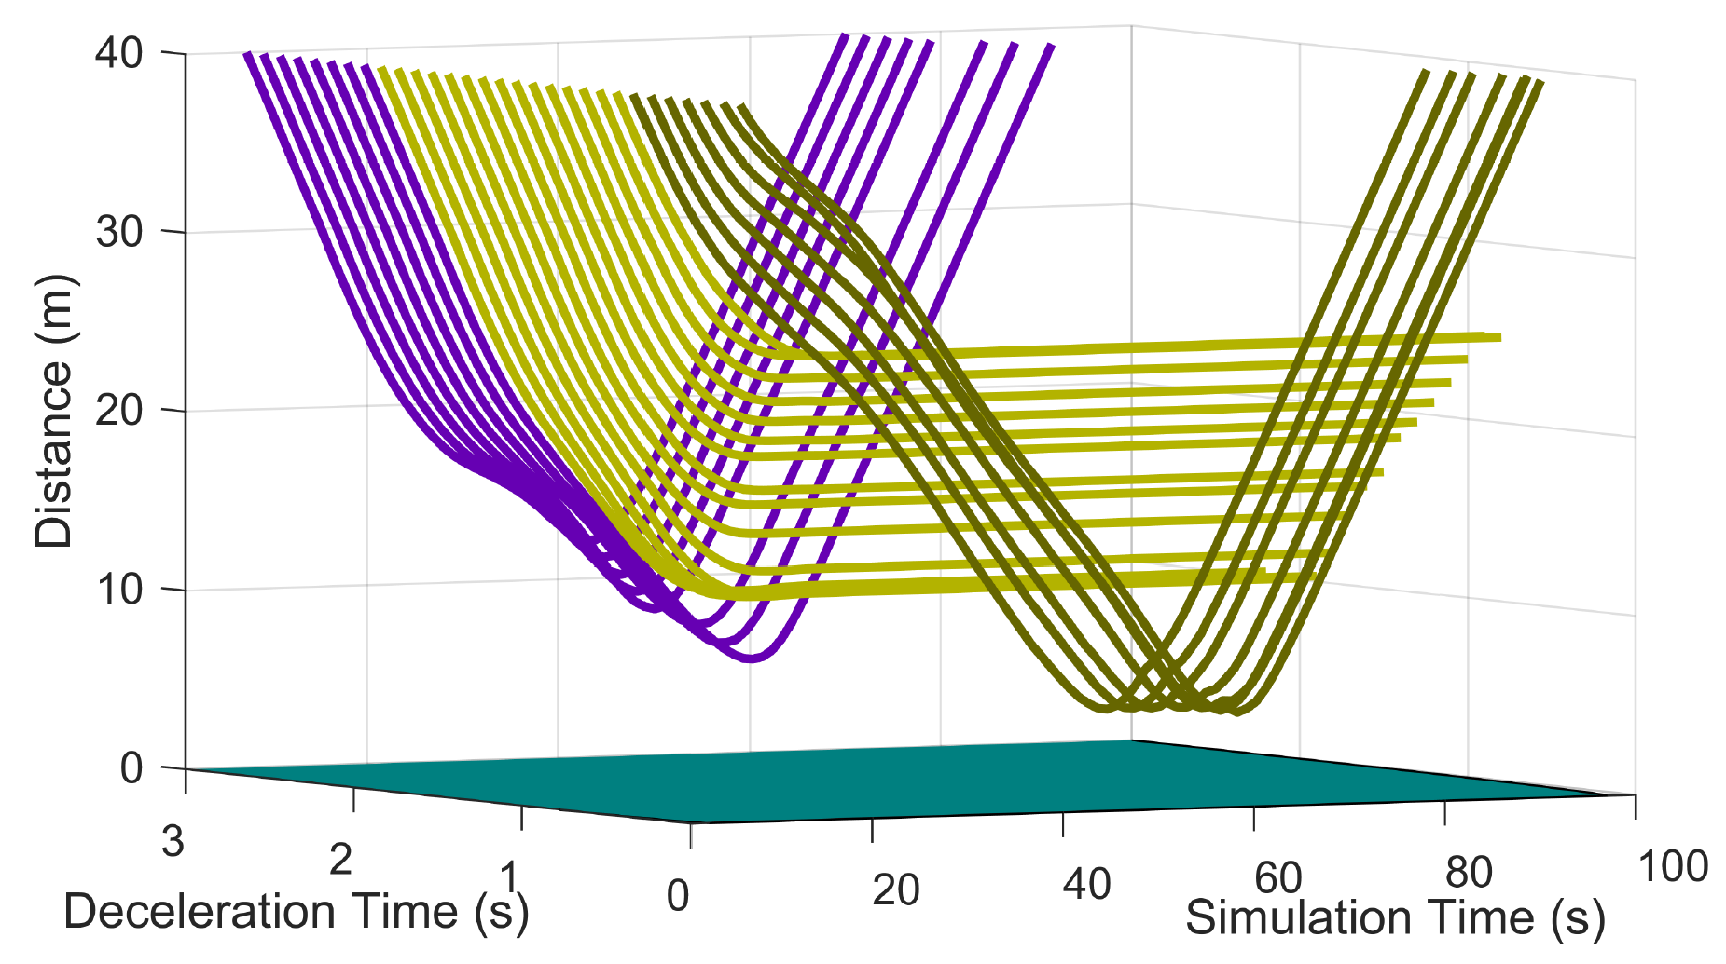
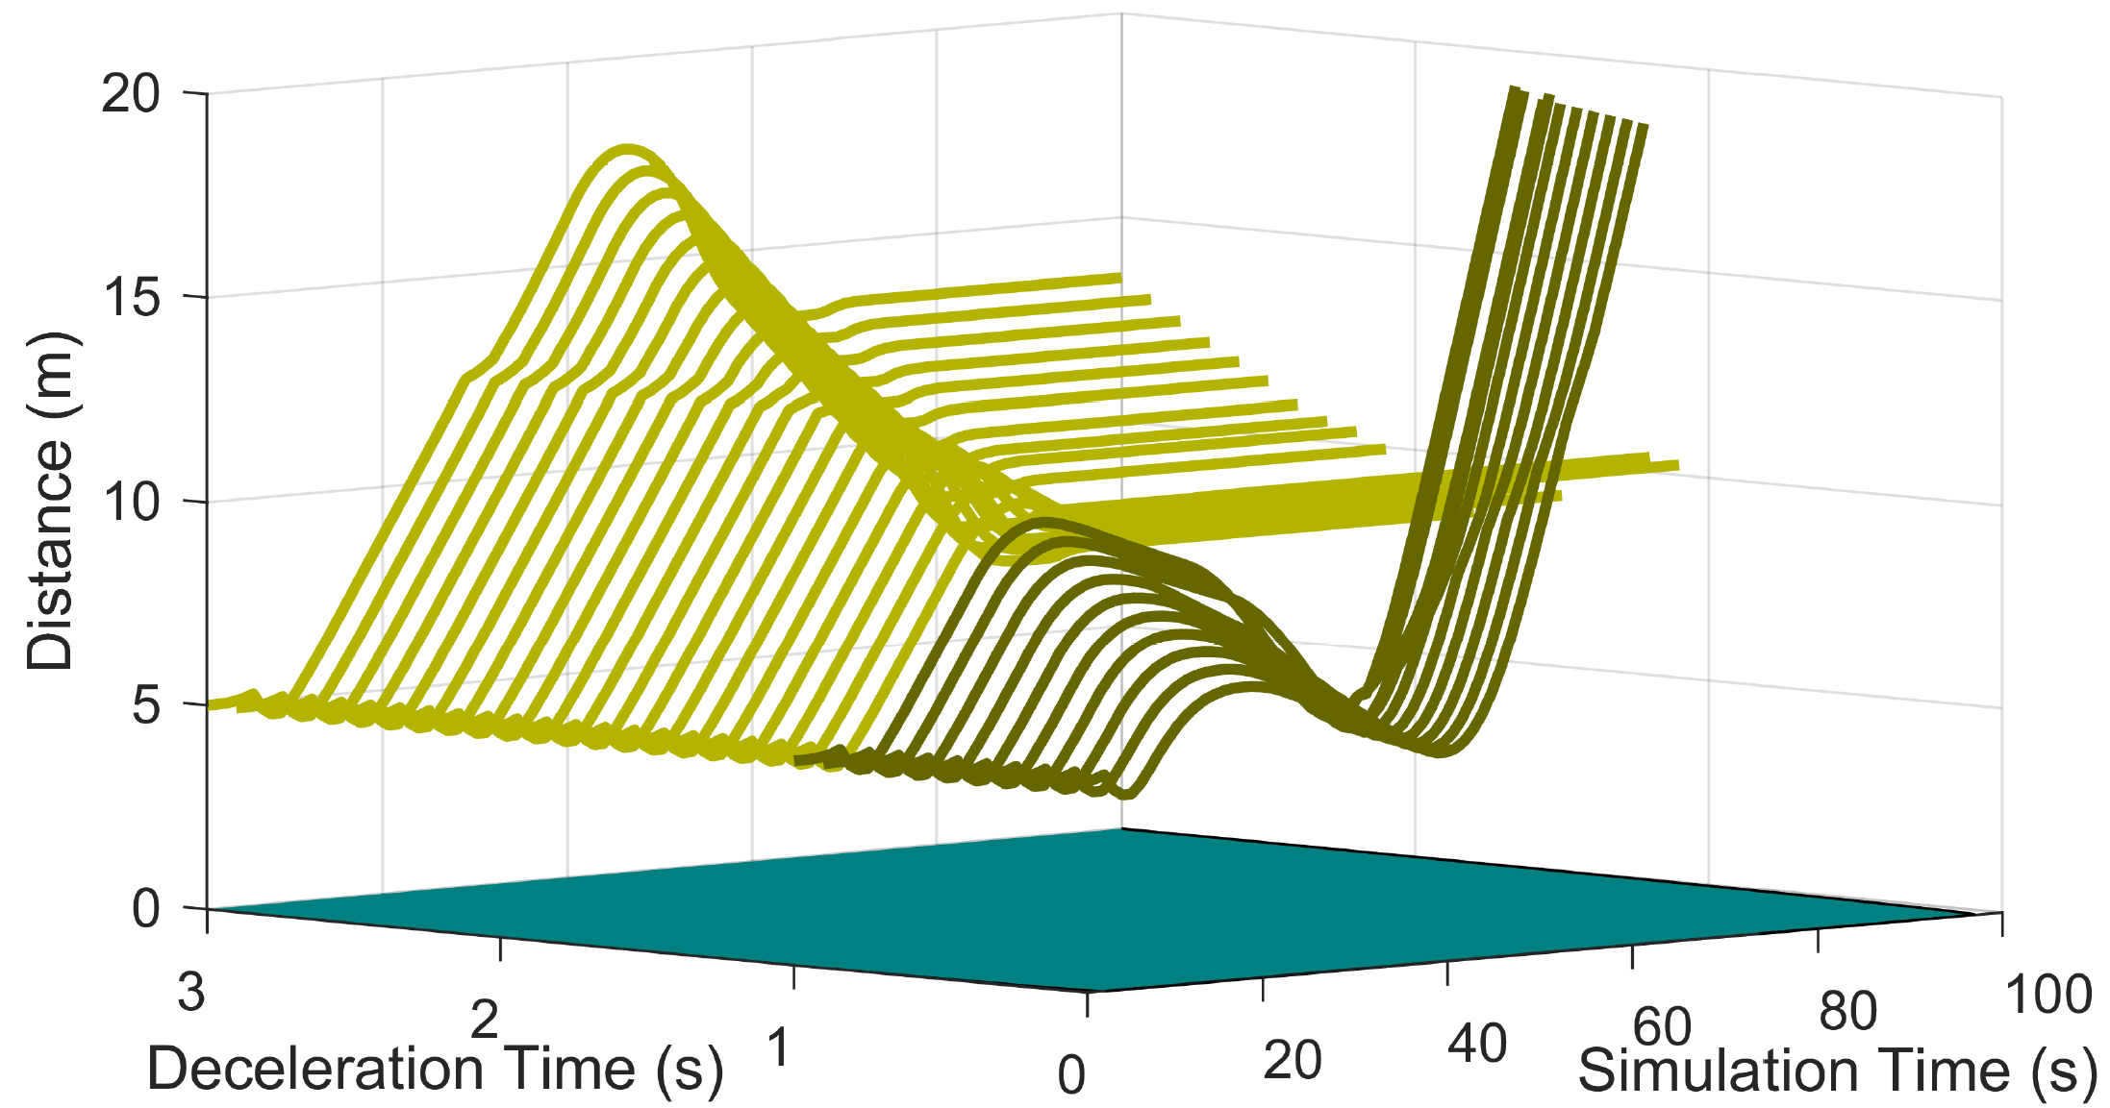
Safety Analysis Experiment
Two case studies: Intersection & Merge
Brute-force fault injection (every 0.1 s)
The CAV with the advantage stops suddenly
The CAV with advantage stops before (dark green), inside (light green) or after (Blue) entering the conflict zone
Intersection
Merge
Intersection
Merge

Slide 25
Demo for Fault Injection

Slide 26
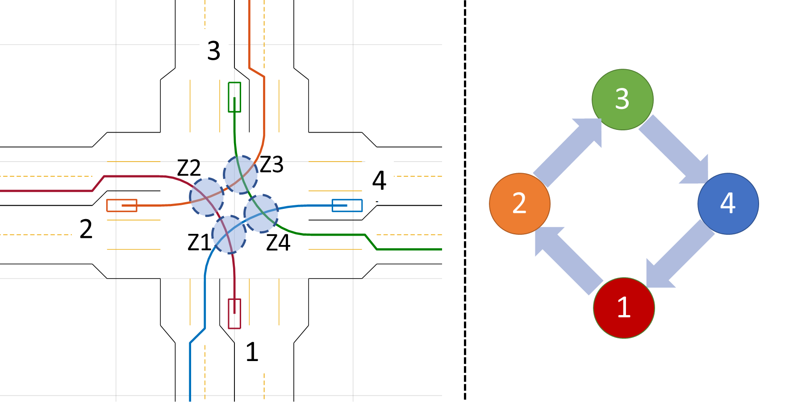
Deadlock Detection and Resolution
We created a scenario where 4 CAVs wants to make a left turn
The have the same distance from the intersection and the same velocity of 10 m/s
CAV1 becomes the leader, and the order is CAV1, CAV2, CAV3, CAV4

Slide 27
Deadlock Demo

Slide 28
Conclusion and Future Works
I developed intersection management algorithms robust against different fault models
Communication delay and processing time
Model mismatch and external disturbances
Rogue vehicle
I developed a new set of RSS rules for Connected Autonomous Vehicles (CAVs) and the complete framework for cooperation of CAVs (Conflict detection, deadlock detection and resolution, motion planning, and control)
A possible future work is to apply optimization-based approaches for computing the advantage

Slide 29
List of Publications/Patents During my Ph.D.
Paper/Journals:
1) Khayatian, Mohammad, Mohammadreza Mehrabian, Harshith Allamsetti, Kai Wei, Po Yu, Chung-Wei Lin, and Aviral Shrivastava. "Cooperative Driving of Connected Autonomous Vehicles in Smart Cities using Responsibility-Sensitive Safety Rules." in proceedings of the ACM International Conference on Cyber-Physical Systems (ICCPS 2021).
2) Khayatian, Mohammad, Rachel Dedinsky, Sarthake Choudhary, Mohammadreza Mehrabian, and Aviral Shrivastava. "R 2 IM–Robust and Resilient Intersection Management of Connected Autonomous Vehicles." In 23rd Intelligent Transportation Systems Conference (ITSC 2020), IEEE, 2020.
3) Khayatian, Mohammad, Mohammadreza Mehrabian, Edward Andert, Rachel Dedinsky, Sarthake Choudhary, Yingyan Lou, and Aviral Shrivastava. "A Survey on Intersection Management of Connected Autonomous Vehicles." ACM Transactions on Cyber-Physical Systems (TCPS 2020), no. 4 (2020): 1-27.
4) Khayatian, Mohammad, Yingyan Lou, Mohammadreza Mehrabian, and Aviral Shrivastava. "Crossroads+: A Time-aware Approach for Intersection Management of Connected Autonomous Vehicles." ACM Transactions on Cyber-Physical Systems (TCPS 2019) , no. 2 (2019): 20.
5) Iannucci, Bob, Aviral Shrivastava, and Mohammad Khayatian. "TickTalk--Timing API for Dynamically Federated Cyber-Physical Systems." (arXiv) preprint arXiv:1906.03982 (2019).
6) Kim, Yooseong, Mohammad Khayatian, and Aviral Shrivastava. "WCET-Aware Stack Frame Management of Embedded Systems Using Scratchpad Memories." In 2019 32nd International Conference on VLSI Design and 2019 18th International Conference on Embedded Systems (VLSID 2019), pp. 543-544. IEEE, 2019.
7) Dedinsky, Rachel, Mohammad Khayatian, Mohammadreza Mehrabian, and Aviral Shrivastava. "A Dependable Detection Mechanism for Intersection Management of Connected Autonomous Vehicles (Interactive Presentation)." In Workshop on Autonomous Systems Design (ASD 2019). Schloss Dagstuhl-Leibniz-Zentrum fuer Informatik, 2019.
8) Khayatian, Mohammad, Mohammadreza Mehrabian, and Aviral Shrivastava. "RIM: Robust Intersection Management for Connected Autonomous Vehicles." In 2018 IEEE Real-Time Systems Symposium (RTSS 2018), pp. 35-44. IEEE, 2018.
9) Mehrabian, Mohammadreza, Mohammad Khayatian, Ahmed Mousa, Aviral Shrivastava, Patricia Derler, YaShian Li-Baboud, Dhananjay Anand, Edward R. Griffor, Hugo Andrade, and John Eidson. "TMA: An Efficient Timestamp-Based Monitoring Approach to Test Timing Constraints of Cyber-Physical Systems." In Design Automation Conference (DAC 2018). 2018.
10) Andert, Edward, Mohammad Khayatian, and Aviral Shrivastava. "Crossroads: Time-Sensitive Autonomous Intersection Management Technique." Proceedings of the 54th Annual Design Automation Conference (DAC 2017). ACM, 2017.
(*Best paper candidate)
11) Shrivastava, Aviral, Mohammadreza Mehrabian, Mohammad Khayatian, Patricia Derler, Hugo Andrade, Kevin Stanton, Ya-Shian Li-Baboud, Edward Griffor, Marc Weiss, and John Eidson. "A Testbed to Verify the Timing Behavior of Cyber-Physical Systems." In Proceedings of the 54th Annual Design Automation Conference (DAC 2017), p. 69. ACM, 2017.
12) Mehrabian, Mohammadreza, Mohammad Khayatian, Aviral Shrivastava, John C. Eidson, Patricia Derler, Hugo A. Andrade, Ya-Shian Li-Baboud, Edward Griffor, Marc Weiss, and Kevin Stanton. “Timestamp Temporal Logic (TTL) for Testing the Timing of Cyber-Physical Systems.” ACM Transactions on Embedded Computing Systems (TECS 2017) 16, no. 5s (2017): 169.
13) Shrivastava, Aviral, Patricia Derler, Ya-Shian Li Baboud, Kevin Stanton, Mohammad Khayatian, Hugo A. Andrade, Marc Weiss, John Eidson, Sundeep Chandhoke. "Time in Cyber-Physical Systems." The International Conference on Hardware/Software Codesign and System Synthesis (CODES+ISSS 2016) 2016.
Patents:
1) Khayatian, Mohammad, Aviral Shrivastava, and Mohammadreza Mehrabian. "Systems and methods for intersection management of connected autonomous vehicles." U.S. Patent Application No. 16/694,451.
2) Andert, Edward, Mohammad Khayatian, and Aviral Shrivastava. "Systems, methods, and apparatuses for implementing time sensitive autonomous intersection management." U.S. Patent Application No. 15/934,772.

