Slide 1
QPMeL
Quantum-Aware Classically-Trained Embeddings via Projective Metric Learning

Slide 2
Background
Understanding the QML and Metric Learning Landscapes

Slide 3
The Promise of QML
Why QML : The goal of QML is to achieve richer representations and faster learning for complex tasks by leveraging the following properties of quantum mechanics.
Enhanced Feature Spaces
Superposition
Entanglement
Processing exponential information states simultaneously.
Creating complex correlations beyond classical reach
Mapping data to high-dimensional Hilbert spaces.

Slide 4
The NISQ Era
NISQ : The NISQ or Near Intermediate Scale Quantum refers to the current generation of quantum devices which are limited in their functionality. Specifically, they suffer from the following challenges -
Limited Qubits
Coherence Time
Circuit Depth
Currently supports dozens, not thousands, of stable qubits.
Quantum states are fragile and quickly decohere into noise collapsing the computation.
Deeper circuits accumulate errors, requiring shallow implementations.

Slide 5
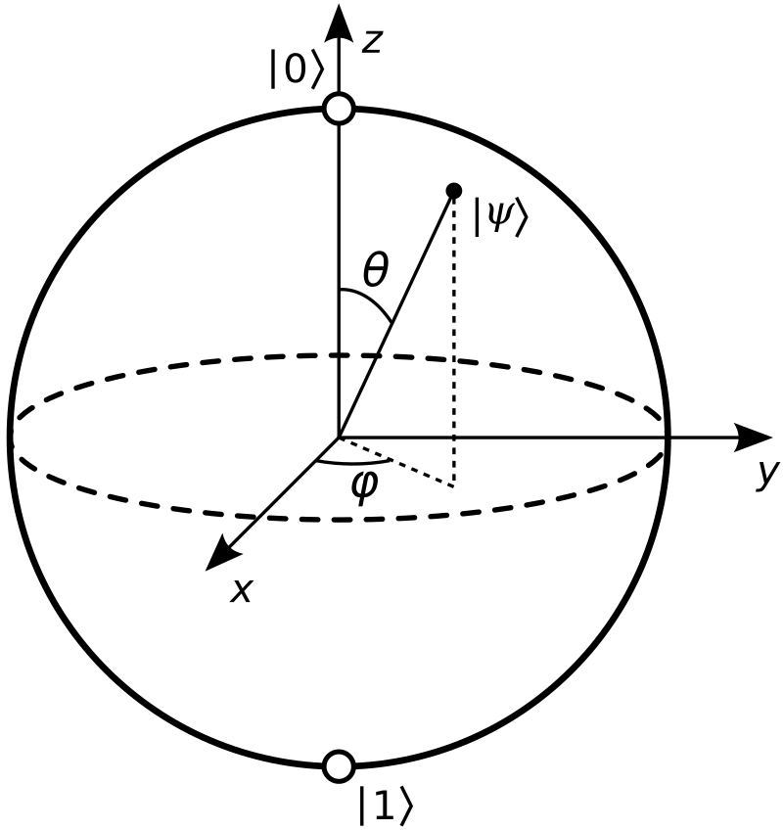
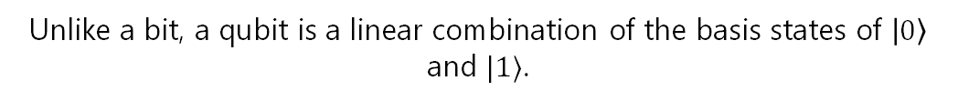

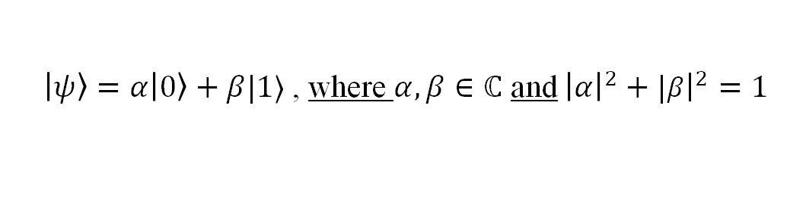
Qubit Geometry
Qubit State Vectors
Bloch Sphere
Unlike a bit, a qubit is a linear combination of the basis states of $\left|0\right\rangle$ and $|1⟩$.
A single qubit state is a point on a unit sphere known as the Bloch Sphere.
Without the loss of generality, we can represent any given qubit with its state vector:
Linear Combination of Basis
Creates a convex combination.
$\left|ψ\right\rangle =α\left|0\right\rangle +β|1⟩$ , where $α,β∈ℂ$ and ${\left|α\right|}^{2}+|{\left.​β\right|}^{2}=1$
Generic Qubit ‘state’
Constants are complex numbers.
Qubit Polar Form
Qubits state vectors can also be written in a Polar Form as:
$$\left|Ψ\right\rangle =\cos{(\frac{θ}{2})}\left|0\right\rangle +e^{iφ}\sin\left(\frac{θ}{2}\right)|1⟩$$
Bloch Sphere Demystified

Slide 6
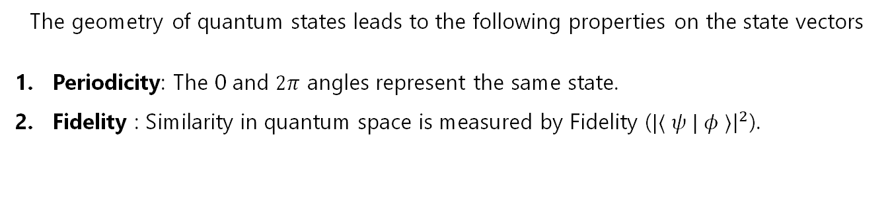
Qubit Geometric Properties
Geometric Properties
The geometry of quantum states leads to the following properties on the state vectors
Periodicity: The 0 and $2π$ angles represent the same state.
Fidelity : Similarity in quantum space is measured by Fidelity ($|⟨ ψ | φ ⟩{\left.​\right|}^{2}$).

Slide 7
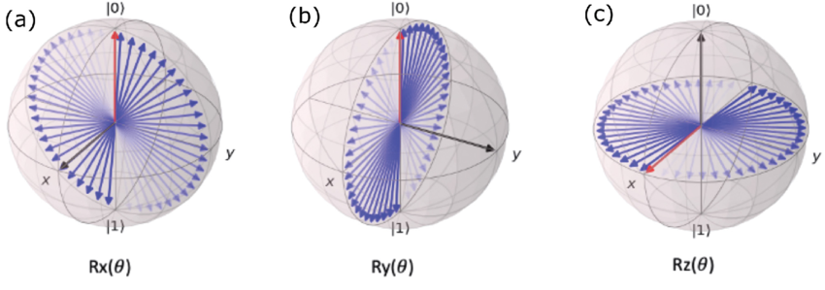

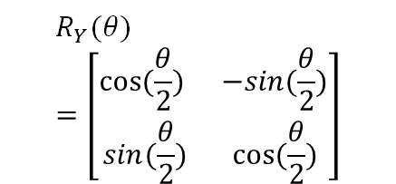




Rotational Computation
Brief : Rotational Gates are parametrized operations that rotate the quantum state by a controllable angle around a specific axis
$R_{X}$ Gate
$R_{y}$ Gate
$R_{z}$ Gate
$$R_{X}(θ)=\left[\begin{matrix}cos(\frac{θ}{2}) & −isin(\frac{θ}{2}) \\ isin(\frac{θ}{2}) & cos(\frac{θ}{2})\end{matrix}\right]$$
$$R_{Y}(θ)=\left[\begin{matrix}cos(\frac{θ}{2}) & −sin(\frac{θ}{2}) \\ sin(\frac{θ}{2}) & cos(\frac{θ}{2})\end{matrix}\right]$$
$$R_{Z}(θ)=\left[\begin{matrix}e^{−\frac{iθ}{2}} & 0 \\ 0 & e^{\frac{iθ}{2}}\end{matrix}\right]$$

Slide 8


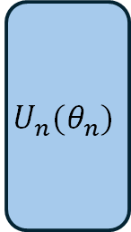

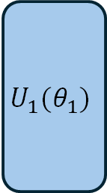

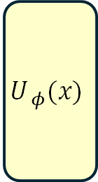



QML Model Skeleton
Trainable quantum circuits consist of data encoding gates ($U_{φ}(x)$) and trainable gates $U_{i}(θ_{i})$. When we alternate these as shown below, we get data re-uploading models.
Classical Data ($x$)
1
2
$$y_{true}$$
3
$$|0⟩$$
$$U_{ φ}(x)$$
$$U_{1}(θ_{1})$$
$$U_{n}(θ_{n})$$
$$ℳ$$
$$y_{pred}$$
Loss
$$|0⟩$$
$∇_{θ}$ Update
1
2
3
Model Layer
Model Output
Training and updates
The combination of data-encoding and trainable unitaries is a layer in a quantum model.
The output of quantum models is a measurable quantity (ex. Expectation) of the final state.
The measured outputs are used with loss functions and optimizers to update the trainable parameters

Slide 9
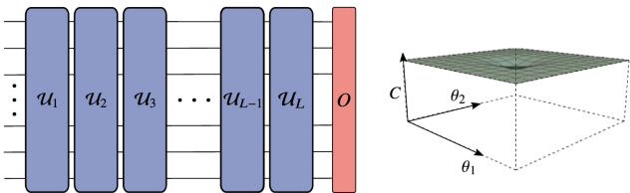
The Barren Plateau Problem
$$∇_{θ} →0$$
Vanishing Gradients
As the number of qubits or number of gates increase, the cost function landscape becomes flat. Training quantum circuits becomes exponentially slow or impossible due to vanishing gradients.

Slide 10
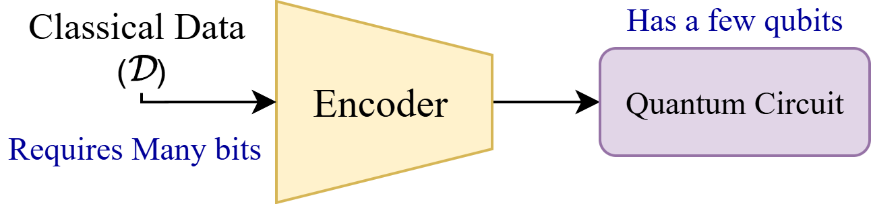
The Encoding Bottleneck
"The effectiveness of encoding often determines the downstream performance of the quantum model."
The Classical data (images/text) must be transformed into quantum states $|ψ⟩.$This is the first and most critical step in any QML workflow.
Since NISQ devices have low qubit counts, the amount of data that can be encoded onto NISQ-era quantum computers creates a bottleneck for computation on classical data and ML.

Slide 11
Types of Encoding
There are 2 main types of data encoding for embedding classical information into quantum states -
Static Encoding
Trainable Encoding
Do not use any training to create encoding circuits
Trained Models (Quantum/ Classical) used to learn encodings

Slide 12

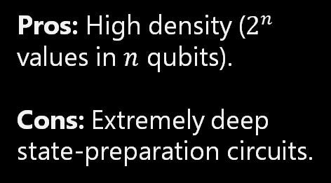

Static Encoding
Static Encoding
Angle Encoding
Data values are encoded as rotation angles ($R_{Z}, R_{X},R_{Y}$)
ex: for a vector $\left\{x_{1}, x_{2},\right\}$, we create the quantum state
$\left(R_{Y}\left(x_{1}\right)|0⟩\right)⊗\left(R_{Y}(x_{2}\right)|0⟩)$
Pros: Hardware efficient.
Cons: Limited expressivity; sparse Hilbert space use.
Do not use any training to create encoding circuits
Amplitude Encoding
Pros: High density ($2^{n}$ values in $n$ qubits).
Cons: Extremely deep state-preparation circuits.
Data is stored in the amplitudes of the quantum state.
ex: for a vector $\left\{x_{1}, x_{2}, x_{3}, x_{4}\right\}$, we create the quantum state
$x_{1}\left|00\right\rangle +x_{2}\left|01\right\rangle +x_{3}\left|10\right\rangle +x_{4}|11⟩$

Slide 13
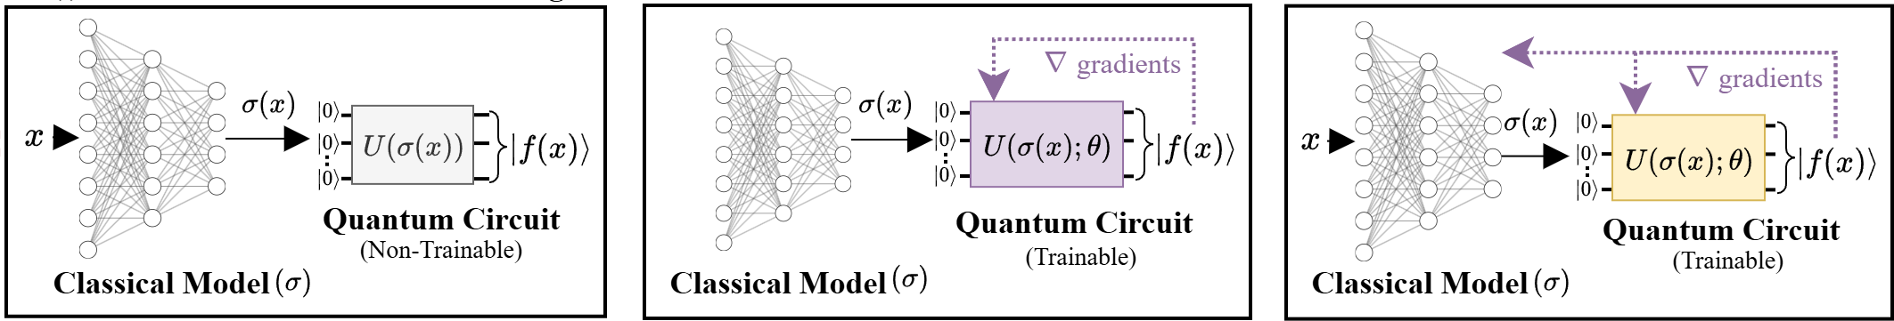
Trainable Encoding
Trainable Encoding
Fully Quantum
Data is statically encoded, and a Variational Quantum model is trained to create optimal encodings.
Trained quantum circuits used to learn encodings
Limitation: Requires many qubits and gates for training leading to barren plateaus
Hybrid Training
Uses trainable classical pre-processing (ex. Autoencoders) before static encoding and quantum training.
(i). Classical Training + Static Quantum
(ii). Classical Training + Quantum Training
(iii). Fully Hybrid Training (Joint Loss)

Slide 14
Limitations of Hybrid Training
Older methods fall into one of 3 types as shown below. Each of them have their own limitations.
(i). Classical Training + Static Quantum
(ii). Classical Training + Quantum Training
(iii). Fully Hybrid Training (Joint Loss)
(i). The classical model is not aware of the quantum feature space and therefore can create encodings that are optimal in Euclidian space but not in quantum Hilbert space.
(ii). Training the quantum model to compensate for the quantum-unaware nature of the classical model requires a lot of gates, leading to barren plateaus.
(iii). The gradients when coming through the quantum circuit can get very small leading to vanishing gradients and making training either model challenging.
Ultimately we ask – “Can we learn dense quantum encodings using classical training while respecting the unique geometry of the Hilbert space?”

Slide 15
QPMeL
QPMeL as the solution.

Slide 16
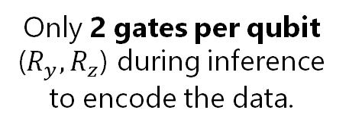
The Promise of QPMeL
Quantum Projective Metric Learning (QPMeL) creates encodings which showcase the following properties which as essential to NISQ devices.
Classically Trained
Quantum-Aware
Shallow Inference
No quantum circuits during training = No Barren Plateaus
Loss function approximates Hilbert Space similarity
Only 2 gates per qubit ($R_{y}, R_{z}$) during inference to encode the data.
This creates a highly trainable, NISQ efficient, and Hilbert-Space Aware encoding to be used with downstream quantum models.

Slide 17
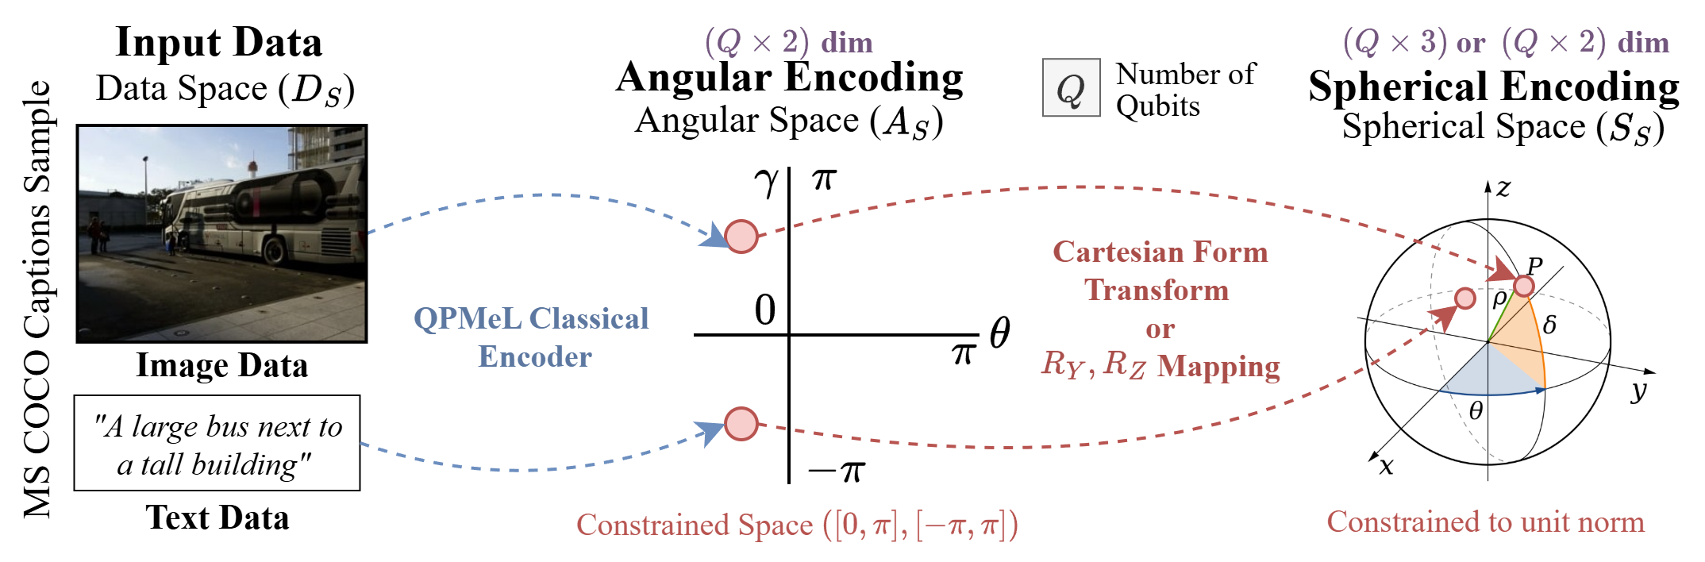
QPMeL Unified Feature Space
2
1
2
1
The unified space is then mapped onto Spherical Encodings.
These represent the Bloch Sphere when using quantum gates for the encoding.
In the classical setting this is done via Polar to Cartesian Conversion
Training data from any modality is first encoded into a unified Real 2-D Vector space on a ‘per qubit’ basis

Slide 18
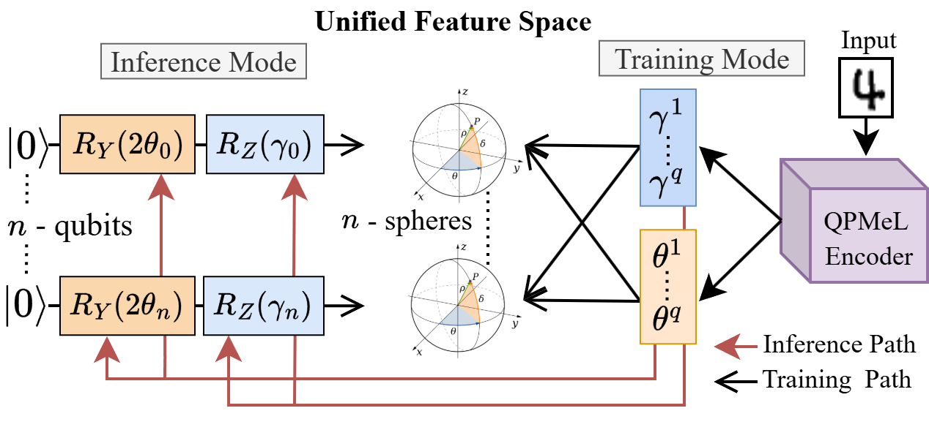
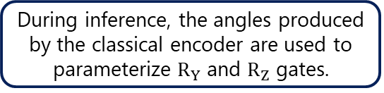
QPMeL Unified Feature Space
| Part 2
1
3
During inference, the angles produced by the classical encoder are used to parameterize $R_{Y}$ and $R_{Z}$ gates.
During training the angles produced by the classical encoder are converted to cartesian polar coordinates
2
3
1
2
Factorized Spherical Embeddings form the feature space of QPMeL

Slide 19
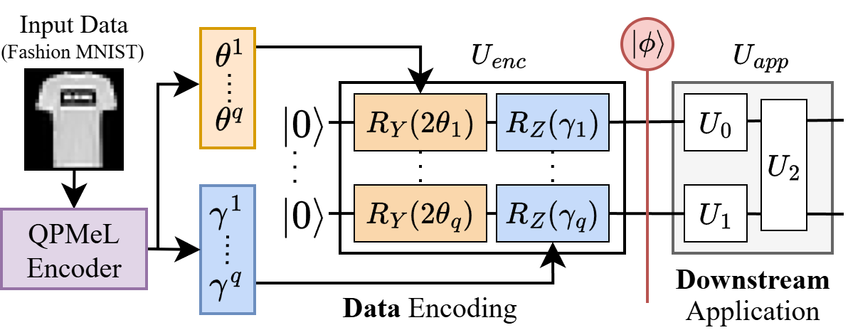
QPMeL During Inference
1
2
1
2
Encodings from a trained classical encoder are used to parameterize a quantum circuits in place of static encoding schemes such as Angle Encoding
Downstream models such as a Quantum Generative Model can use the well separated quantum states as a starting point to learn a complex probability distribution for sampling.

Slide 20
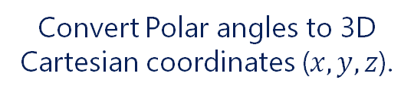
Projective Metric Function (PMeF)
This is the "brain" of the quantum-aware loss function. It computes similarity using a two-step process:
Step 1: Conversion
Step 2: Kernel
Convert Polar angles to 3D Cartesian coordinates ($x, y, z$).
Apply the Complex Kernel Function (CKF) to compute Fidelity.

Slide 21

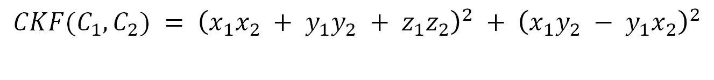
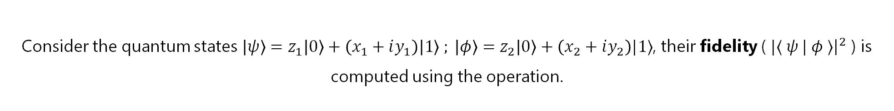


Complex Kernel Function (CKF)
Consider the quantum states $\left|ψ\right\rangle =z_{1}\left|0\right\rangle +\left(x_{1}+iy_{1}\right)\left|1\right\rangle ; \left|φ\right\rangle =z_{2}\left|0\right\rangle +\left(x_{2}+iy_{2}\right)|1⟩$, their fidelity ( $|⟨ ψ | φ ⟩{\left.​\right|}^{2}$ ) is computed using the operation.
$${\left|\left[\begin{matrix}z_{1} & x_{1}−iy_{1}\end{matrix}\right]× \left[\begin{matrix}z_{2} \\ x_{2}+i y_{2}\end{matrix}\right]\right|}^{2} ={|z}_{1}⋅z_{2}+\left(x_{1}−iy_{1}\right)⋅\left(x_{2}+iy_{2}\right){\left.​\right|}^{2}$$
The CKF computes fidelity using only the real cartesian vectors $C_{1}$ and $C_{2}$
$$C_{1}={(x}_{1},y_{1},z_{1})$$
$$C_{2}={(x}_{2},y_{2},z_{2})$$
$$CKF(C_{1},C_{2}) = {\left(x_{1}x_{2} + y_{1}y_{2} + z_{1}z_{2}\right)}^{2} + {\left(x_{1}y_{2} − y_{1}x_{2}\right)}^{2}$$
Vector Dot Product $(C_{1},C_{2})$
Indexed Vector Dot
with element-wise multiply
Both of these operations are easily vector accelerated. This kernel allows the classical optimizer to "see" the distance between quantum states in linear time without complex numbers.

Slide 22
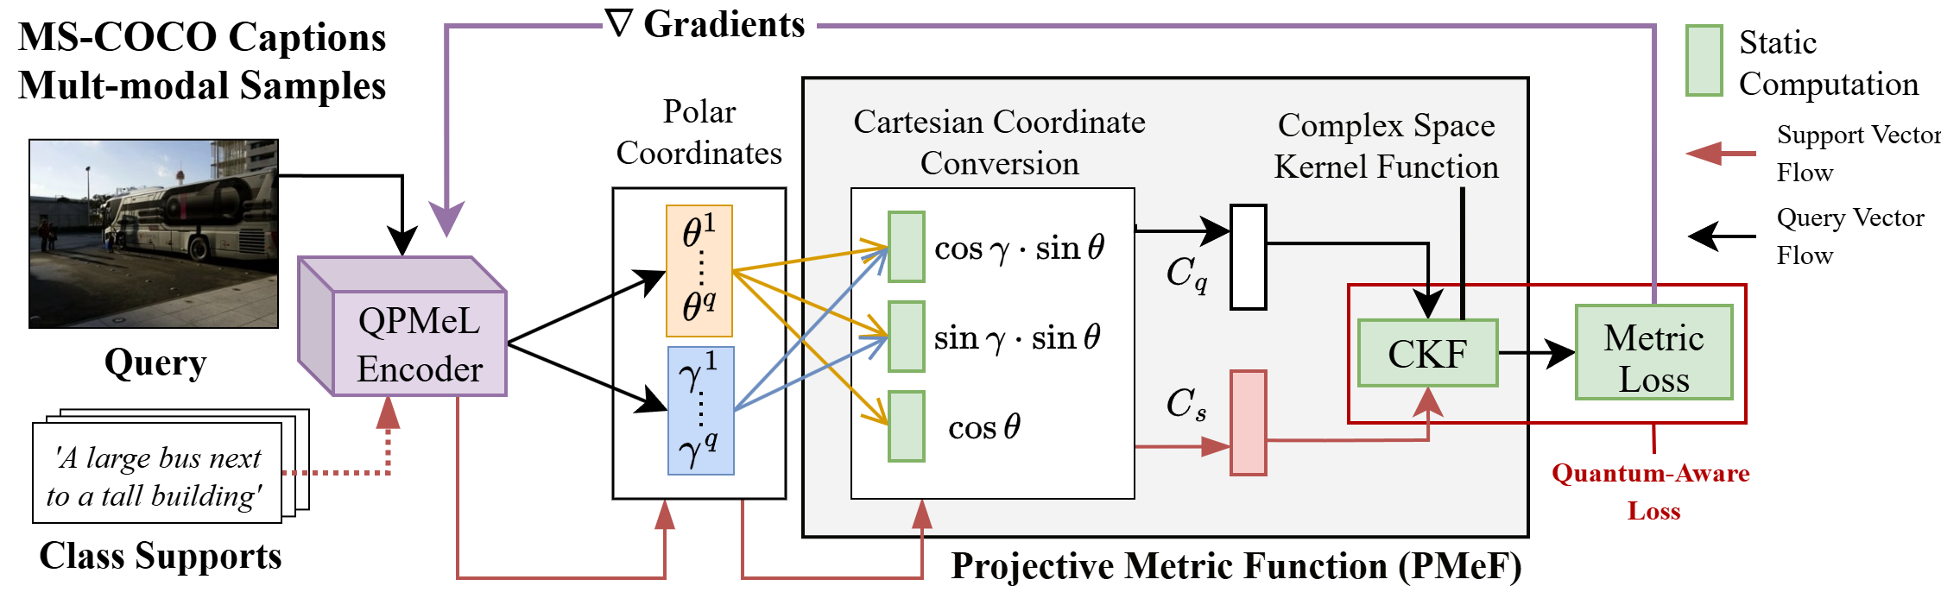
QPMeL Training
1
2
3
3
2
The Complex Kernel Functions allows us to compute metric similarity in higher dimensional Hilbert Space.
1
Angular Coordinates are converted into cartesian coordinates to be used with metric functions.
The classical encoder creates split encodings as angular coordinates

Slide 23
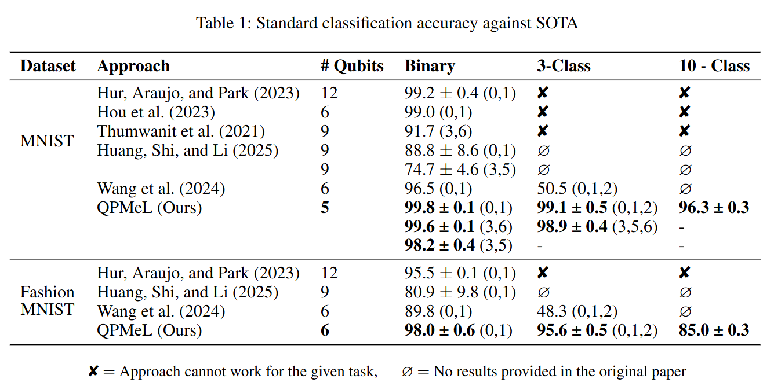
Results
| Against current metric learning approaches
QPMeL greatly outperforms previous metric learning models while using fewer qubits.

Slide 24
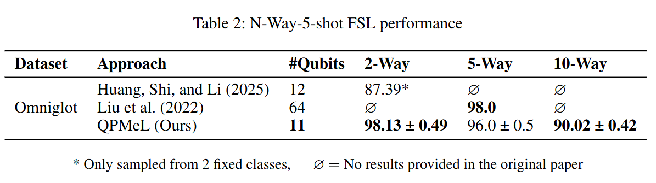








Results
| Against current metric learning approaches on FSL
FSL (3-way)
Same Class
$${M_{1}=PMEF((θ}_{A},γ_{A}),\left(θ_{I_{1}},γ_{I_{1}}\right))$$
$$I_{C}^{1}$$
$$I_{C}^{2}$$
$$I_{C}^{3}$$
Correct Classification:
$$\max\left(M_{1},M_{2},M_{3}\right)=M_{2}$$
$$I_{A}$$
$$M_{2}={PMEF((θ}_{A},γ_{A}),\left(θ_{I_{2}},γ_{I_{2}}\right))$$
QPMeL
$${M_{3}=PMEF((θ}_{A},γ_{A}),\left(θ_{I_{3}},γ_{I_{3}}\right))$$
QPMeL matches the few shot results of Liu et al while using 1/6th the number of qubits.

Slide 25
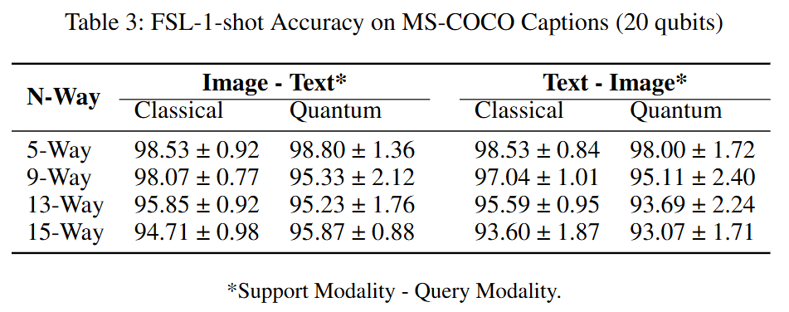







Results
| Multi-modal metric learning results
Image – Text (3-way)
Same Class
$${M_{1}=PMEF((θ}_{A},γ_{A}),\left(θ_{T1},γ_{T1}\right))$$
$$T_{C}^{1}$$
$$T_{C}^{2}$$
$$T_{C}^{3}$$
Correct Classification:
$$\max\left(M_{1},M_{2},M_{3}\right)=M_{2}$$
$$I_{A}$$
$$M_{2}={PMEF((θ}_{A},γ_{A}),\left(θ_{T2},γ_{T2}\right))$$
QPMeL
$${M_{3}=PMEF((θ}_{A},γ_{A}),\left(θ_{T3},γ_{T3}\right))$$
The fully classical training of QPMeL enables learning multi-modal embeddings.

Slide 26
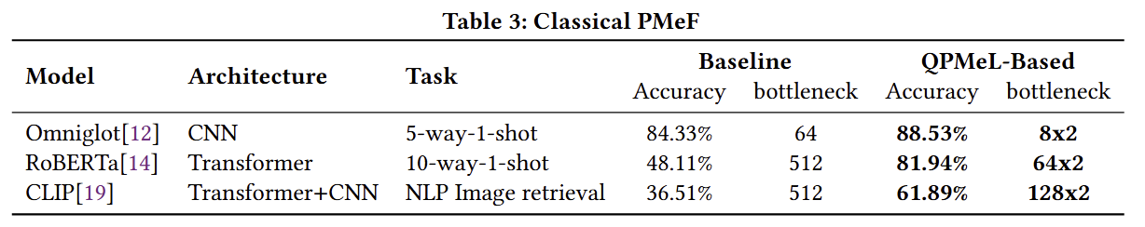












Results
| Improving on classical models
Baseline
QPMeL- Based
$$(B×1)$$
$$(B^{′}×2)$$
$$I_{A}$$
$$E_{A}$$
$$I_{A}$$
$${(θ}_{A},γ_{A})$$
Encoder
QPMeL Encoder
$$⟨E_{A},E_{C}⟩$$
$$PMeF$$
$$I_{C}$$
$$E_{C}$$
Similarity
Score
$$I_{C}$$
$${(θ}_{C},γ_{C})$$
Similarity
Score
When training classical models with PMeF we see an improvement in performance while also achieving a reduction in the size of the bottleneck or embedding vector.

Slide 27
Summary
The current generation of quantum computers dubbed the ‘NISQ-era’ devices are limited in – (1). Number of qubits, (2). Coherence times (how long the system is viable) , and (3). Circuit Depth (the number of gates we can apply).
This creates a bottleneck in the amount of classical data that can be encoded onto to quantum computers for tasks such as machine learning.
Therefore, efficient encoding methods need to be devised to solve this task – often using machine learning (classical or quantum).
However, increasing the number of qubits or number of gates leads to ‘Barren Plateaus’ which makes training difficult.
QPMeL introduces fully classically trained quantum-aware encoding scheme that during inference only uses 2 gates per qubit. QPMeL also uses fewer qubit compared to previous methods therefore addressing both causes of barren plateaus and the challenges of NISQ devices.

Slide 28
Metric Learning Basics
Learning Similarity
The goal is to learn an embedding space where:
  Similar items are close together.
  Dissimilar items are pushed far apart
Loss
Functions
Triplet Loss
Prototypical Loss
Minimizes the distance between an anchor and a positive sample while maximizing the distance between the anchor and a negative sample by at least a predefined margin.
Classifies samples by minimizing the Euclidean distance between a query point and the mean representation (prototype) of its corresponding class in an embedding space.

Slide 29
Few-Shot Learning (FSL)
FSL tests a model's ability to generalize to new, unseen classes with minimal data. Prototypical Loss is used to train this family of models. There are 4 terms which define training in FSL.
Supports
N-Shot
Set of examples for the classes to classify from one.
Number of classes to choose from.
Queries
K-Shot
New samples to classify based on Support.
Examples per class (Support set).

Slide 30
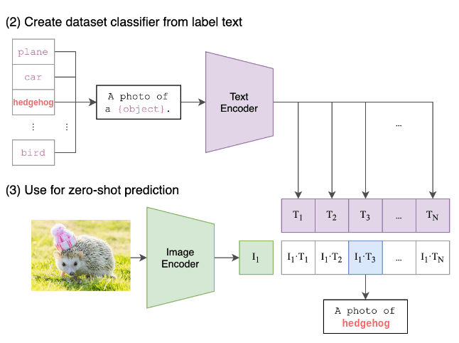
Multi-Modal Encodings
Modern Multi-Modal AI aligns images and text into a single shared space for downstream tasks such as Image Generation or Few-Shot Classification. The CLIP model from OpenAI is a landmark model in this domain:
Multi-Modal Encoders
1
Unified Feature Space
Clip uses separate text and image encoders to encode data into feature vectors
1
Clip trains both encoders such that the embeddings are in the same vector space.
1
2
Inner Product
Due to being in the same feature space, the inner product is the similarity between the text and images for a trained model
2

